Slide 1





TEAM DETAILS
Team name: Aether Labs
Team leader name: Nishit Bhardwaj
Problem statement: Indoor Navigation & Personnel Locator with AI Assistant

Slide 2
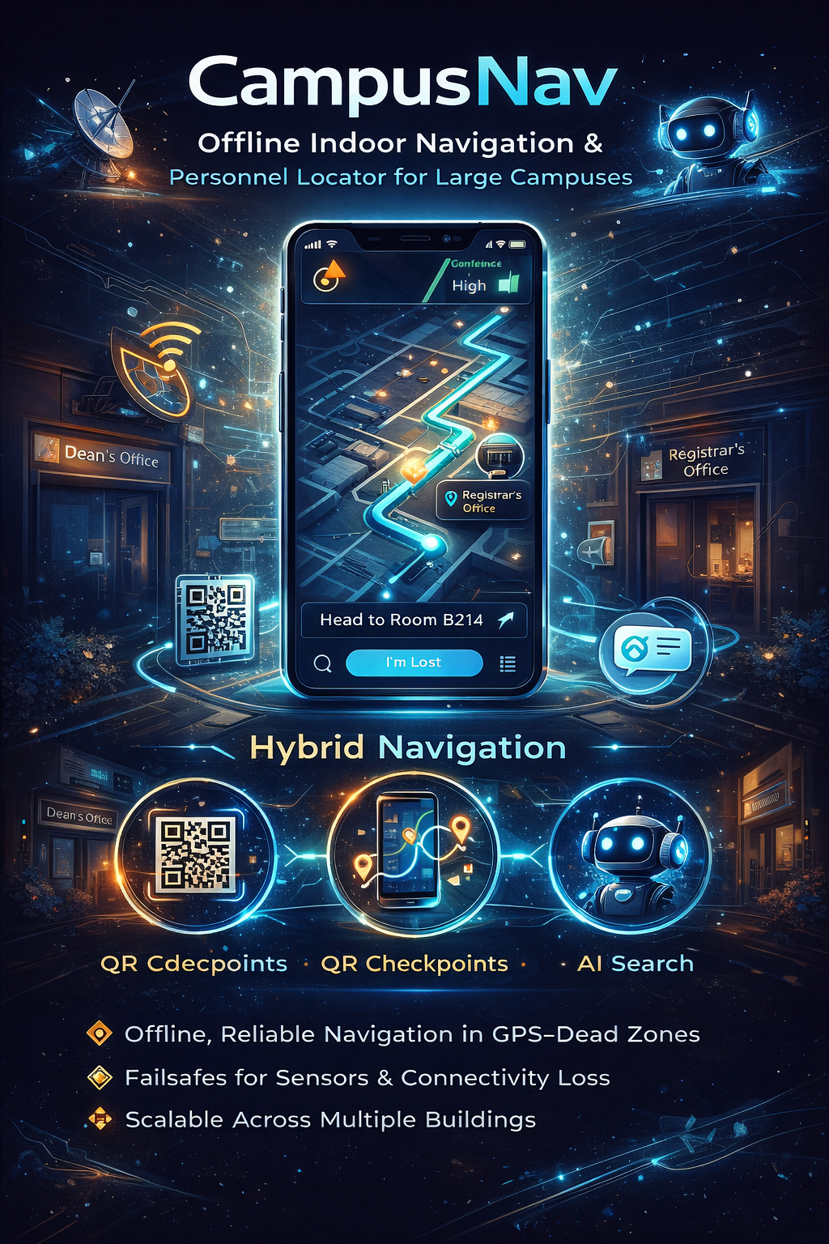
Brief About The Idea
CampusNav is an offline-first indoor navigation and personnel locator system designed for large campuses where GPS and internet connectivity are unreliable. It enables users to quickly locate offices, departments, and key personnel such as Deans, Registrars, and faculty members through an intuitive navigation experience.
The system uses a hybrid approach that combines sensor-based movement tracking, QR-code checkpoints, and visual guidance to ensure reliable indoor navigation. An integrated AI-powered search assistant allows users to find destinations using natural queries, even without internet access. Built to handle real-world constraints, CampusNav provides robust fallback mechanisms and scalable design, improving accessibility and reducing navigation challenges across campuses.

Slide 3
1. How is CampusNav different from existing solutions?
Most existing indoor navigation solutions rely on GPS, continuous internet connectivity, or costly infrastructure such as Bluetooth beacons, which are unreliable indoors. CampusNav follows an offline-first, infrastructure-light approach, combining sensors, QR checkpoints, and visual guidance. This makes it more practical, deployable, and reliable in real-world indoor environments.
2. How will CampusNav solve the problem?
CampusNav uses a hybrid navigation model where users initialize their location via QR codes or landmarks and receive step-by-step indoor guidance using sensor-based tracking. When sensors or connectivity fail, the system seamlessly switches to visual or manual guidance. An offline AI-powered search enables users to locate offices or personnel quickly and reliably.
3. USP of the proposed solution
The key USP of CampusNav is its ability to function reliably without internet, GPS, or additional infrastructure. Its hybrid navigation approach, graceful fallback mechanisms, and offline AI-based search ensure uninterrupted guidance under real-world constraints, prioritizing usability and trust over unrealistic precision.

Slide 4
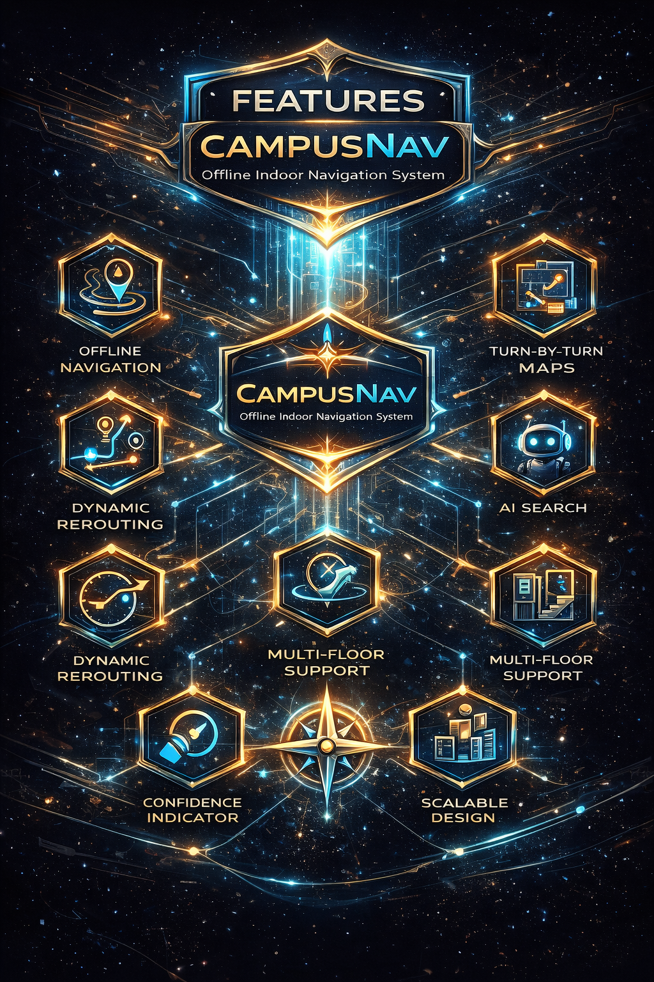
List Of Features Offered By The Solution
CampusNav offers a reliable indoor navigation experience through its offline-first design and hybrid positioning approach. The system provides clear turn-by-turn guidance using sensor-based tracking, QR checkpoints, and visual cues to ensure accurate navigation in GPS-dead zones. An integrated AI search enables users to quickly locate offices and key personnel, while dynamic rerouting adapts paths when obstacles are encountered. Multi-floor support, confidence indicators, and manual fallback modes ensure uninterrupted guidance under real-world constraints, making the solution scalable, dependable, and user-friendly across large campuses.

Slide 5
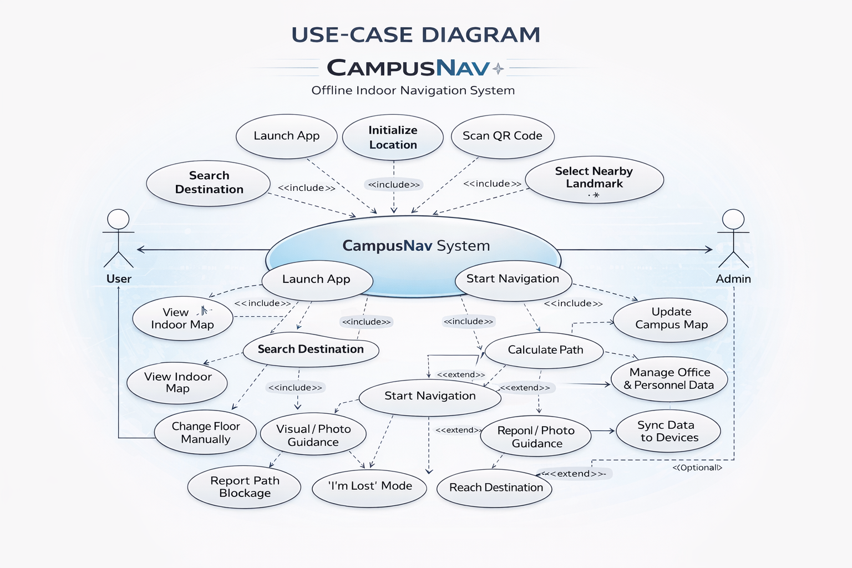
Use-Case Diagram
The use-case diagram illustrates how users and administrators interact with the CampusNav system. Users can launch the application, initialize their location using QR codes or nearby landmarks, search for destinations or personnel, and start indoor navigation. During navigation, users may change floors, access visual or photo-based guidance, report blocked paths, or activate the “I’m Lost” mode, ensuring continuous assistance. Administrators support the system by updating campus maps, managing office and personnel data, and syncing information to user devices. The diagram highlights a clear separation between user operations and administrative functions, ensuring reliable, offline-first navigation with scalable system management.

Slide 6
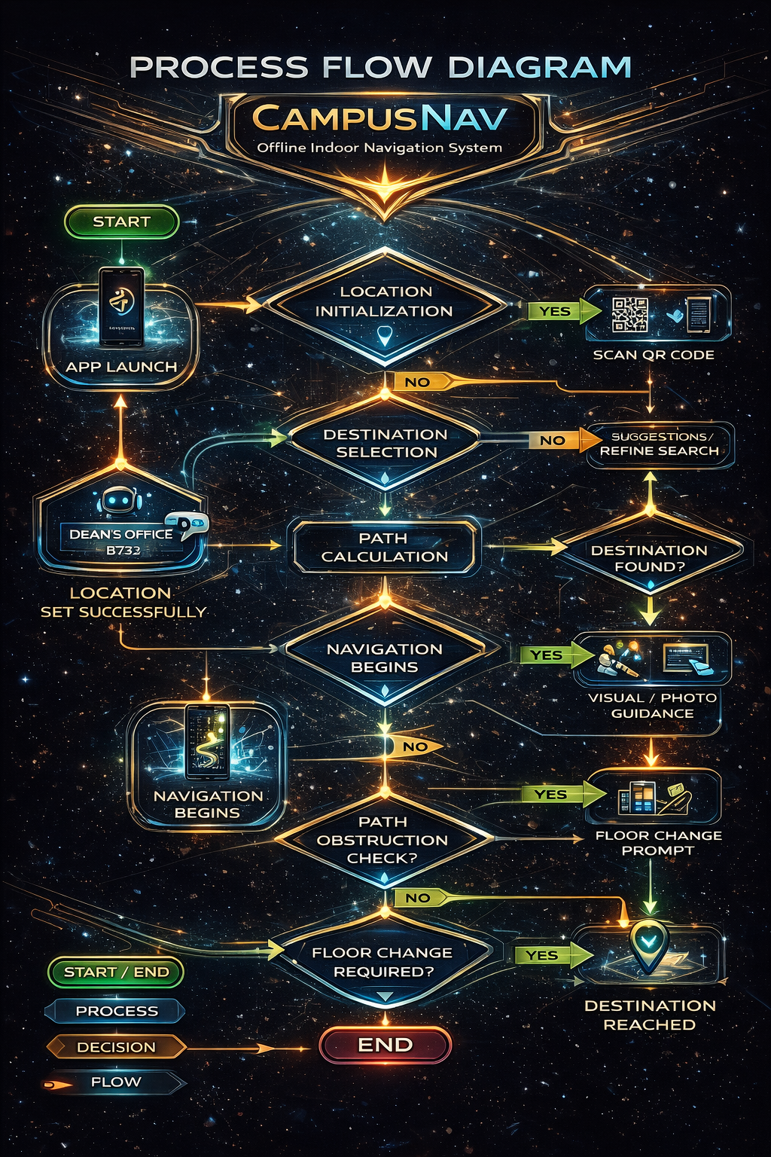
Process Flow Diagram
The process flow diagram explains the step-by-step operation of the CampusNav system from start to finish. The flow begins when the user launches the app and initializes their location using a QR code or nearby landmark. After selecting a destination, the system calculates the optimal indoor route and starts navigation. As the user moves, the system continuously checks sensor reliability and adapts guidance accordingly. If sensors fail or a path is blocked, fallback mechanisms such as visual guidance or rerouting are triggered. The flow concludes when the user successfully reaches the destination, ensuring reliable navigation under real-world constraints.

Slide 7
Technologies To Be Used In The Solution
Flutter (Dart) for cross-platform mobile application development
A* Pathfinding Algorithm for efficient indoor route calculation
SVG-based floor maps with CustomPainter for lightweight map rendering
Device Sensors (accelerometer, gyroscope, magnetometer) for movement tracking
QR Code Scanner for accurate indoor location initialization​
Offline AI search using fuzzy string matching for destination queries​
Local databases (Hive / Isar) for offline data storage​
Optional Backend using Java (Spring Boot) for data synchronization and updates

Slide 8
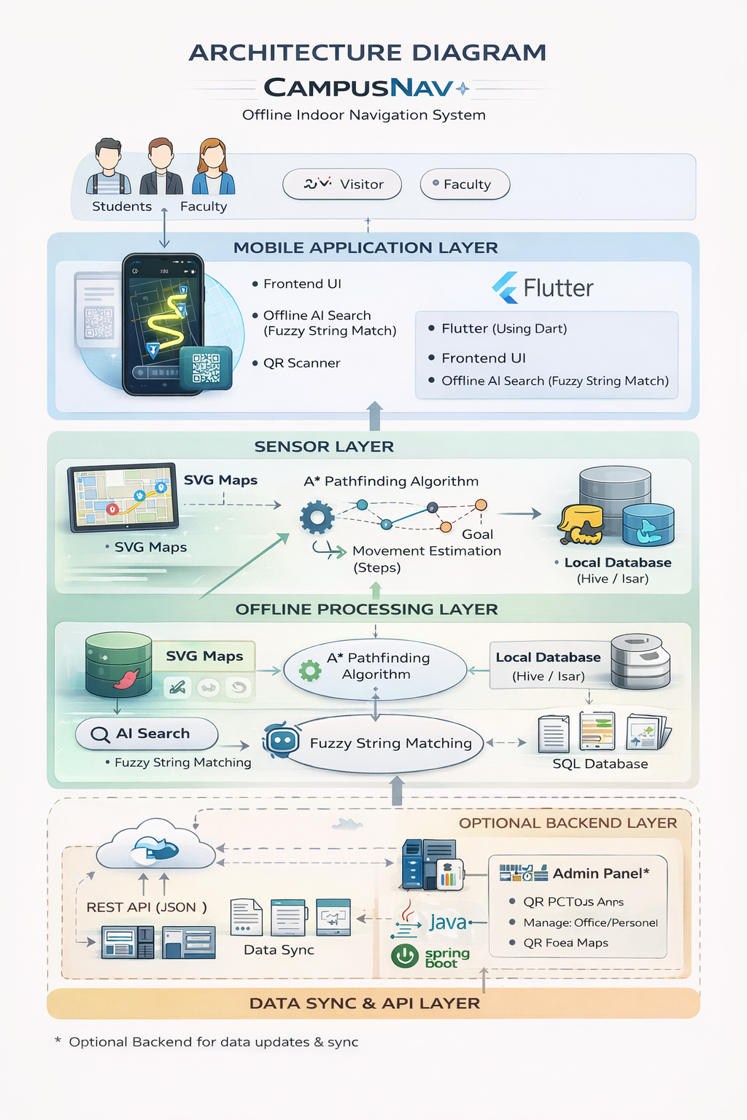
Architecture Diagram Of The Proposed Solution
The architecture diagram illustrates the layered design of the CampusNav system, emphasizing offline reliability and modularity. Users interact with the mobile application built using Flutter, which handles the user interface, AI-based search, and QR scanning. Sensor inputs and SVG-based floor maps feed into the offline processing layer, where the A* pathfinding algorithm, movement estimation, and fuzzy search logic operate entirely on the device using a local database. An optional backend layer, implemented using Java Spring Boot, is included only for data synchronization and administrative updates. This separation ensures navigation remains functional without internet access while supporting future scalability and centralized data management.

Slide 9
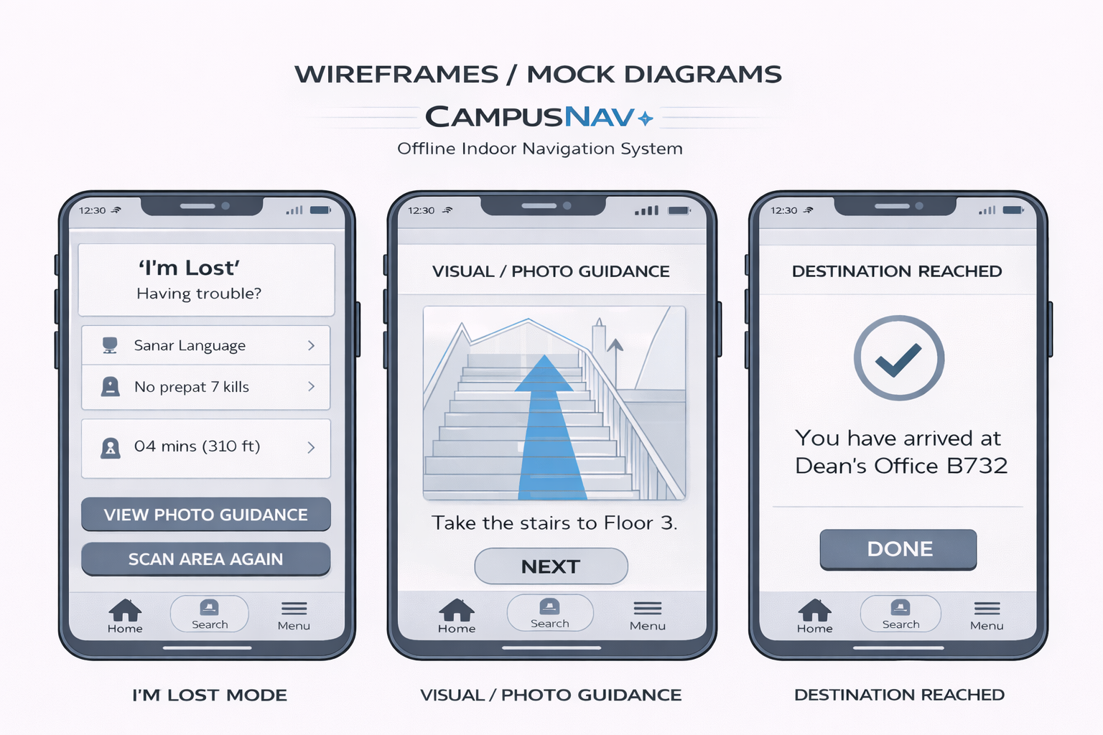
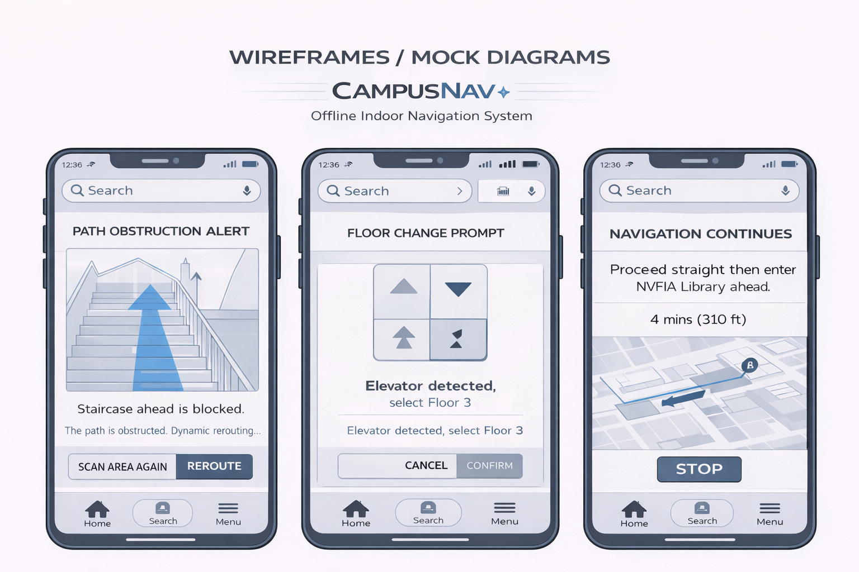
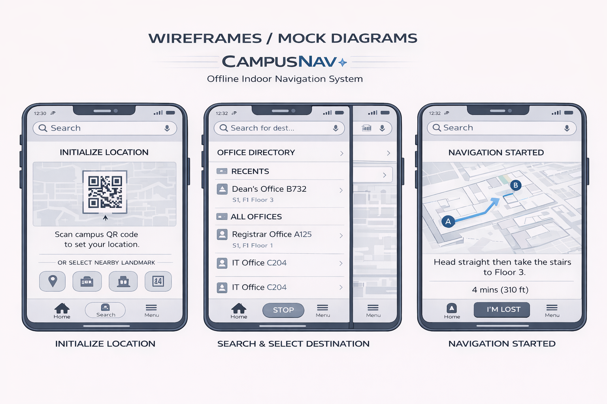
Wireframes/Mock Diagrams Of The Proposed Solution
These screens represent the adaptive navigation phase of CampusNav. When a pathway is blocked, the system detects the obstruction and alerts the user while dynamically recalculating an alternative route. If a floor change is required, the app prompts the user to select stairs or an elevator, ensuring smooth vertical navigation. Once resolved, navigation continues seamlessly with updated directions and time estimates. This flow demonstrates CampusNav’s ability to respond intelligently to real-world indoor challenges, maintaining reliable guidance without internet connectivity or external infrastructure.

Slide 10
Limitations & Our Solutions (Key Engineering Decisions)
Limitation | Our Solution
Sensor drift indoors | Rail-snapping technique keeps user position aligned to mapped corridors instead of raw sensor output
No internet connectivity | Local-first architecture with offline maps, data, and navigation logic
Unknown starting location | QR-code scanning or nearby landmark selection for accurate initialization
Floor detection inaccuracies | Manual floor selector to avoid unreliable automatic floor detection
Blocked or inaccessible paths | Dynamic rerouting using graph-based path recalculation
Live demo risk | Built-in demo mode to simulate navigation reliably during presentations

Slide 11
Scalability & Future Scope
CampusNav is designed with scalability at its core, enabling seamless expansion beyond a single building or campus. The system can be extended to support multiple buildings and floors through modular map data. A dedicated admin dashboard can allow institutions to manage maps, offices, and personnel information efficiently.
Future enhancements include real-time data updates when connectivity is available, along with improved accessibility features such as voice guidance and haptic feedback. With its offline-first and infrastructure-light design, CampusNav can be adapted for complex environments like hospitals, airports, malls, and corporate campuses, making it a practical and deployable real-world solution.

Slide 12
Conclusion & Impact
CampusNav addresses a real and recurring problem faced by students, visitors, and staff on large campuses by providing a reliable indoor navigation solution. Built with an offline-first approach, the system functions effectively even in GPS-dead zones and poor connectivity environments. Its hybrid navigation design ensures consistent performance under real-world constraints while remaining scalable across buildings and institutions. By requiring no additional hardware or costly infrastructure, CampusNav offers a practical, deployable, and cost-effective solution with significant real-world impact.

